Slide 1
Software Project Planning
(and Estimation)

Slide 2
Software Project Planning
The overall goal of project planning is to establish a pragmatic strategy for controlling, tracking, and monitoring a complex technical project.
Why?
So the end result gets done on time, with quality!

Slide 3
Project Planning Task Set-I
Establish project scope
Determine feasibility
Analyze risks
Define required resources
  Determine require human resources
  Define reusable software resources
  Identify environmental resources

Slide 4
Project Planning Task Set-II
Estimate cost and effort
  Decompose the problem
  Develop two or more estimates using size, function points, process tasks or use-cases
  Reconcile the estimates
Develop a project schedule
  Establish a meaningful task set
  Define a task network
  Use scheduling tools to develop a timeline chart
  Define schedule tracking mechanisms

Slide 5
Software Project Plan ?
Project Scope
Risks
Estimates
Schedule
Control strategy
Software
Project
Plan

Slide 6
To Understand Scope ...
Understand the customers needs
understand the business context
understand the project boundaries
understand the customer’s motivation
understand the likely paths for change
understand that ...
Even when you understand,
nothing is guaranteed!

Slide 7
What is Scope?
Software scope describes
  The functions and features that are to be delivered to end-users
  The data that are input and output
  The performance, constraints, interfaces, and reliability that bound the system.
Scope is defined using one of two techniques:
  A narrative description of software scope is developed after communication with all stakeholders.
  A set of use-cases is developed by end-users.

Slide 8
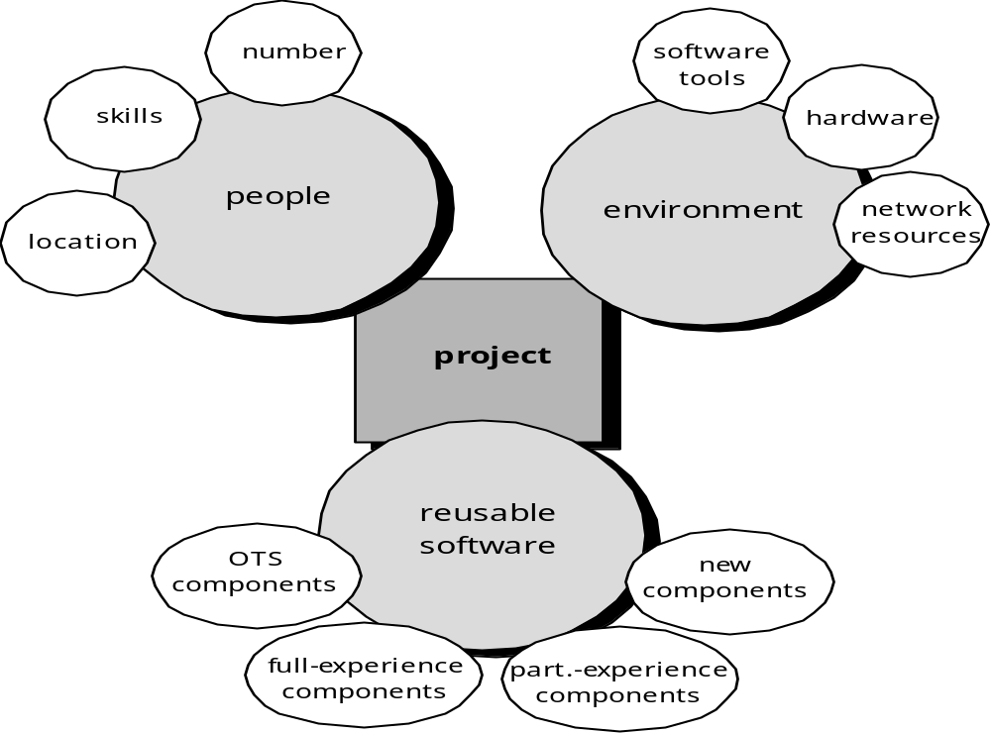
Resources
* OTS : Off The Shelf (i.e.Available on Contract)

Slide 9
Estimation
Estimation of resources, cost, and schedule for a software engineering effort requires
  experience
  access to good historical information (metrics)
  the courage to commit to quantitative predictions when qualitative information is all that exists
Estimation carries inherent risk and this risk leads to uncertainty

Slide 10

Project Estimation
Project scope must be understood
Elaboration (decomposition) is necessary
Historical metrics are very helpful
At least two different techniques should be used
Uncertainty is inherent in the process

Slide 11
Estimation Techniques
Past (similar) project experience
Conventional estimation techniques
  task breakdown and effort estimates
  size (e.g., FP) estimates
Empirical models
Automated tools

Slide 12
Estimation Accuracy
Based on …
  the degree to which the planner has properly estimated the size of the product to be built
  the degree to which the project plan reflects the abilities of the software team
  the stability of product requirements and the environment that supports the software engineering effort.

Slide 13
Functional Decomposition
Functional
Decomposition
Statement
of
Scope
Perform a Grammatical “Parse”

Slide 14
Conventional Methods:
LOC/FP Approach
Compute LOC/FP using estimates of information domain values
Use historical data to build estimates for the project

Slide 15
Example : LOC-Based Estimation
As an example of LOC and FP problem-based estimation techniques, let us consider a software package to be developed for a computer-aided design application for mechanical components. A review of the System Specification indicates that the software is to execute on an engineering workstation and must interface with various computer graphics peripherals including a mouse, digitizer, high resolution color display and laser printer.

Slide 16
Example : LOC-Based Estimation
Using the System Specification as a guide, a preliminary statement of software scope can be developed:
The CAD software will accept two- and three-dimensional geometric data from an engineer. The engineer will interact and control the CAD system through a user interface that will exhibit characteristics of good human/machine interface design. All geometric data and other supporting information will be maintained in a CAD database. Design analysis modules will be developed to produce the required output, which will be displayed on a variety of graphics devices. The software will be designed to control and interact with peripheral devices that include a mouse, digitizer, laser printer, and plotter.

Slide 17
Example : LOC-Based Estimation
This statement of scope is preliminary—it is not bounded. Every sentence would have to be expanded to provide concrete detail and quantitative bounding. For example, before estimation can begin the planner must determine what "characteristics of good human/machine interface design" means or what the size and sophistication of the "CAD database" are to be.

Slide 18
Example : LOC-Based Estimation
For simplicity let us assume that further refinement has occurred and that the following major software functions are identified:
  User interface and control facilities (UICF)
  Two-dimensional geometric analysis (2DGA)
  Three-dimensional geometric analysis (3DGA)
  Database management (DBM)
  Computer graphics display facilities (CGDF)
  Peripheral control function (PCF)
  Design analysis modules (DAM)

Slide 19
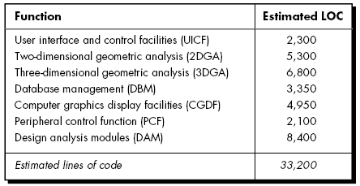
Example: LOC Approach
Average productivity for systems of this type = 620 LOC/pm.
Burdened labor rate =$8000 per month, the cost per line of code is approximately $13.
Based on the LOC estimate and the historical productivity data, the total estimated project cost is $431,000 and the estimated effort is 54 person-months.

Slide 20
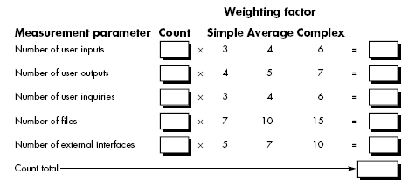
Example: FP Approach
Function points are computed by completing the table shown in Figure
Five information domain characteristics are determined and counts are provided in the appropriate table location.

Slide 21
FP Approach (Contd.)
Information domain values are defined in the following manner:
  Number of user inputs. Each user input that provides distinct applicationoriented data to the software is counted. Inputs should be distinguished from inquiries, which are counted separately.
  Number of user outputs. Each user output that provides applicationoriented information to the user is counted. In this context output refers to reports, screens, error messages, etc. Individual data items within a report are not counted separately.
  Number of user inquiries. An inquiry is defined as an on-line input that results in the generation of some immediate software response in the form of an on-line output. Each distinct inquiry is counted.
  Number of files. Each logical master file (i.e., a logical grouping of data that may be one part of a large database or a separate file) is counted.
  Number of external interfaces. All machine readable interfaces (e.g., data files on storage media) that are used to transmit information to another system are counted.

Slide 22
FP Approach (Contd.)
To compute function points (FP), the following relationship is used:
FP = count total [0.65 + 0.01 Σ(Fi)]
  where count total is the sum of all FP entries
  The Fi (i = 1 to 14) are "complexity adjustment values" based on responses to the following questions
    Does the system require reliable backup and recovery?
    Are data communications required?
    Are there distributed processing functions?
    Is performance critical?
    Will the system run in an existing, heavily utilized operational environment?

Slide 23
FP Approach (Contd.)
    Does the system require on-line data entry?
    Does the on-line data entry require the input transaction to be built over multiple screens or operations?
    Are the master files updated on-line?
    Are the inputs, outputs, files, or inquiries complex?
    Is the internal processing complex?
    Is the code designed to be reusable?
    Are conversion and installation included in the design?
    Is the system designed for multiple installations in different organizations?
    Is the application designed to facilitate change and ease of use by the user?

Slide 24
FP Approach (Contd.)
Factor | Value
Backup and recovery | 4
Data communications | 2
Distributed processing | 0
Performance critical | 4
Existing operating environment | 3
On-line data entry | 4
Input transaction over multiple screens | 5
Master files updated on-line | 3
Information domain values complex | 5
Internal processing complex | 5
Code designed for reuse | 4
Conversion/installation in design | 3
Multiple installations | 5
Application designed for change | 5
Total | 52

Slide 25
FP Approach (Contd.)
The estimated number of FP is derived:
FP_{estimated} = count-total X [0.65 + 0.01 X S(F_{i})]
FP_{estimated} = count-total X [0.65 + 0.01 X 52)]
FP_{estimated} =320 X 1.17
FP_{estimated} = 375
organizational average productivity = 6.5 FP/pm.
burdened labor rate = $8000 per month, approximately $1230/FP.
Based on the FP estimate and the historical productivity data, total estimated project cost is $461,000 and estimated effort is 58 person-months.

Slide 26
Process-Based Estimation
Obtained from “process framework”
framework activities
application
functions
Effort required to accomplish
each framework activity for each application function

Slide 27
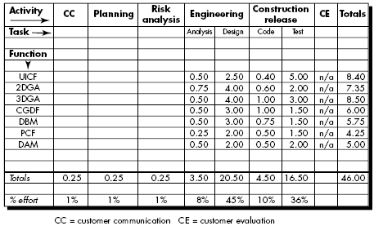
Process-Based Estimation Example
Based on an average burdened labor rate of $8,000 per month, the total estimated project cost is $368,000 and the estimated effort is 46 person-months.

Slide 28
Empirical Estimation Models
The Structure of Estimation Models
E = A + B x (ev)^{C}
where
A, B, and C are empirically derived constants,
E is effort in person-months,
ev is the estimation variable (either LOC or FP).
* Empirical : Derived from experiment and observation rather than theory

Slide 29
Empirical Estimation Models
Among the many LOC-oriented estimation models proposed in the literature are
  Walston-Felix model E = 5.2 x (KLOC)^{0.91}
  Bailey-Basili model E = 5.5 + 0.73 x (KLOC)^{1.16}
  Boehm simple model E = 3.2 x (KLOC)^{1.05}
  Doty model for KLOC > 9 E = 5.288 x (KLOC)^{1.047}
FP-oriented models
  Albrecht and Gaffney model E = -13.39 + 0.0545 FP
  Kemerer model E = 60.62 x 7.728 x 10⁻⁸FP³
  Matson, Barnett and Mellichamp model
    E = 585.7 + 15.12 FP

Slide 30
COnstructive COst MOdel.
COCOMO-II
( Successor of COCOMO - introduced in 80s)
COCOMO II is actually a hierarchy of estimation models that address the following areas:
  Application composition model. Used during the early stages of software engineering, when prototyping of user interfaces, consideration of software and system interaction, assessment of performance, and evaluation of technology maturity are paramount.
  Early design stage model. Used once requirements have been stabilized and basic software architecture has been established.
  Post-architecture-stage model. Used during the construction of the software.

Slide 31
COCOMO-II
Sizing information
  object points,
  function points,
  lines of source code.
The object point is an indirect software measure (like FP) that is computed using counts of the number of
  screens (at the user interface),
  reports,
  components likely to be required to build the application.
Each object instance (e.g., a screen or report) is classified into one of three complexity levels (simple, medium, or difficult)
  Complexity is a function of the number and source of the client and server data tables that are required to generate the screen or report and the number of views or sections presented as part of the screen or report.

Slide 32
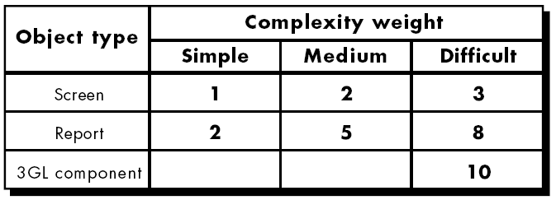
COCOMO-II
Once complexity is determined, the number of screens, reports, and components are weighted according to Table
The object point count is determined by multiplying the original number of object instances by the weighting factor.

Slide 33
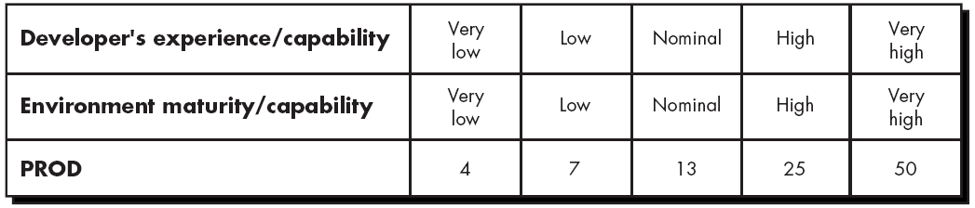
COCOMO-II
When component-based development or general software reuse is to be applied, the percent of reuse (%reuse) is estimated and the object point count is adjusted:
NOP = (object points) x [(100 - %reuse) / 100]
where NOP is defined as new object points
Now
estimated effort = NOP/PROD
Where PROD ( Productivity Rate ) may be derived from

Slide 34
The Software Equation
A dynamic multivariable model
E = [LOC x B^{0.333}/P]³ x (1/t⁴)
where
E = effort in person-months or person-years
t = project duration in months or years
B = “special skills factor”
P = “productivity parameter” that reflects:
      Overall process maturity and management practices
      The extent to which good software engineering practices are used
      The level of programming languages used
      The state of the software environment
      The skills and experience of the software team
      The complexity of the application

Slide 35
Estimation for OO Projects-I
Develop estimates using effort decomposition, FP analysis, and any other method that is applicable for conventional applications.
Using object-oriented requirements modeling develop use-cases and determine a count.
From the analysis model, determine the number of key classes
Categorize the type of interface for the application and develop a multiplier for support classes:
  Interface type Multiplier
  No GUI 2.0
  Text-based user interface 2.25
  GUI 2.5
  Complex GUI 3.0

Slide 36
Estimation for OO Projects-II
Multiply the number of key classes (step 3) by the multiplier to obtain an estimate for the number of support classes.
Multiply the total number of classes (key + support) by the average number of work-units per class. Lorenz and Kidd suggest 15 to 20 person-days per class.
Cross check the class-based estimate by multiplying the average number of work-units per use-case

Slide 37
Estimation for Agile Projects
Each user scenario (a mini-use-case) is considered separately for estimation purposes.
The scenario is decomposed into the set of software engineering tasks that will be required to develop it.
Each task is estimated separately. Note: estimation can be based on historical data, an empirical model, or “experience.”
  Alternatively, the ‘volume’ of the scenario can be estimated in LOC, FP or some other volume-oriented measure (e.g., use-case count).
Estimates for each task are summed to create an estimate for the scenario.
  Alternatively, the volume estimate for the scenario is translated into effort using historical data.
The effort estimates for all scenarios that are to be implemented for a given software increment are summed to develop the effort estimate for the increment.

Slide 38
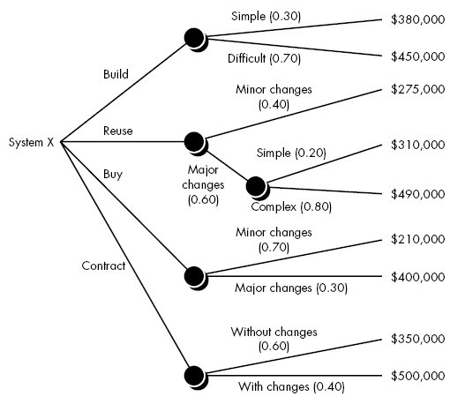
The Make/Buy Decision

Slide 39

Computing Expected Cost
expected cost =
(path probability) x (estimated path cost)
i
i
For example, the expected cost to build is:
similarly,

Slide 40
___________________

Slide 41
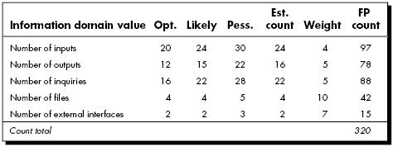
FP Approach (Contd.)

